Slide 1




Saad Ahmed Shaikh
SQL Data Analytics Project
Hospital Management Systems

Slide 2






Business Context & Problem Statement
Business Context:
Hospitals operate with multiple interconnected processes such as patient registration, appointment scheduling, doctor allocation, treatment delivery, and billing.
Each of these processes generates structured data, but without proper analysis:
  Patient wait times increase
  Doctors may be overworked or underutilized
  Revenue leakages go unnoticed
  Operational inefficiencies remain hidden
The hospital management wants to use historical data to understand patient flow, doctor performance, treatment demand, and revenue generation to improve operational efficiency and decision-making.
01

Slide 3

Business Context & Problem Statement
Problem Statement:
The objective of this project is to analyze hospital operational data using SQL to:
  Understand patient visit and treatment patterns
  Evaluate doctor utilization and workload distribution
  Identify high-demand treatments and revenue drivers
  Detect inefficiencies in appointments and billing processes
  The analysis aims to convert raw hospital data into actionable insights that can support better scheduling, resource allocation, and financial planning.
02

Slide 4

Dataset Overview
The dataset represents a simplified Hospital Management System consisting of five core tables that capture patient care and hospital operations.
1. Patients Table:
  Stores demographic and identity information of patients
  Each patient is uniquely identified
  Forms the base entity for appointments and treatments
Key concepts: patient history, repeat visits, demographics
2. Doctors Table:
  Contains doctor details and specializations
  Used to analyze workload, specialization demand, and performance
Key concepts: doctor utilization, department analysis
3. Appointments Table:
  Captures scheduled visits between patients and doctors
  Includes appointment dates and status
Key concepts: patient flow, appointment completion, scheduling efficiency
03

Slide 5

Dataset Overview
4. Treatments Table:
  Records treatments provided during appointments
  Links medical services to patients and doctors
Key concepts: treatment frequency, service demand, clinical workload
5. Billing Table:
  Contains financial records related to treatments
  Tracks billed amounts and payment status
Key concepts: revenue analysis, unpaid bills, financial performance
04

Slide 6
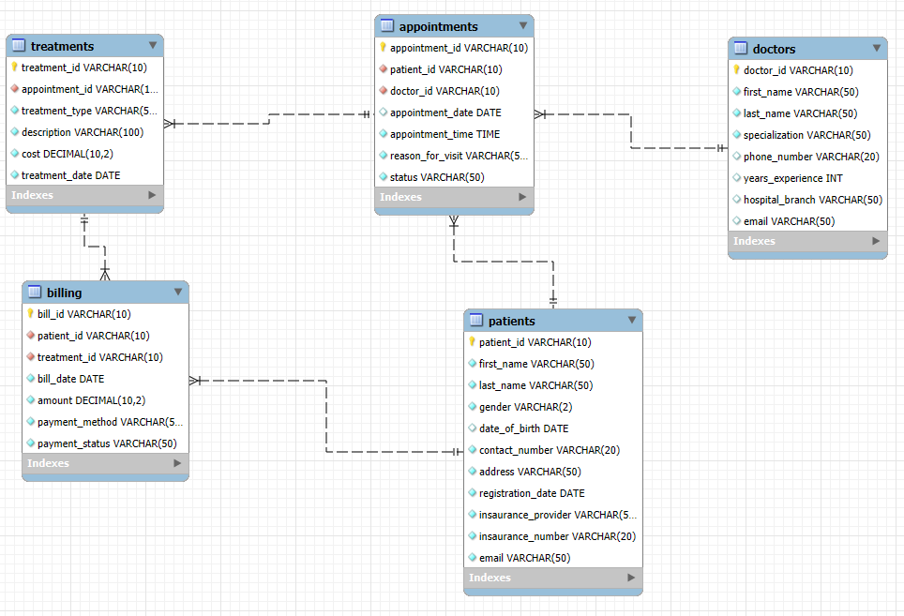



ER Diagram
05

Slide 7
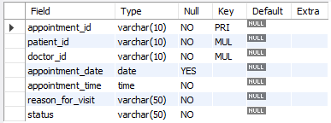
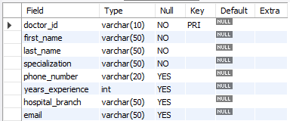
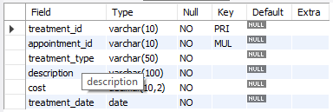
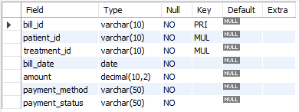

Different Tables Structure
describe appointments;
describe doctors;
describe treatments;
describe billing;
06

Slide 8
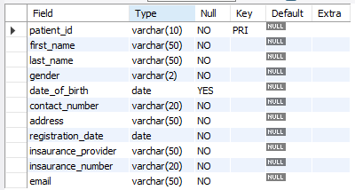
Different Tables Structure
describe patients;
07

Slide 9
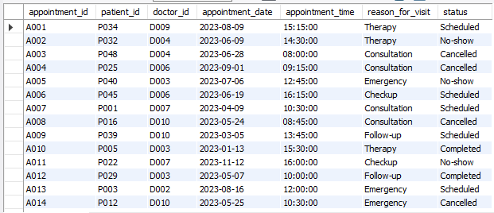
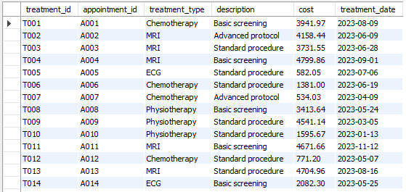
Table Content
select * from appointments;
select * from treatments;
08

Slide 10

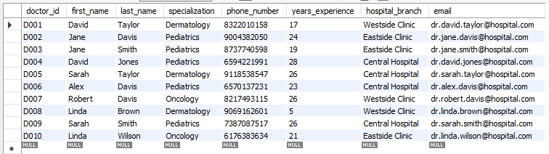
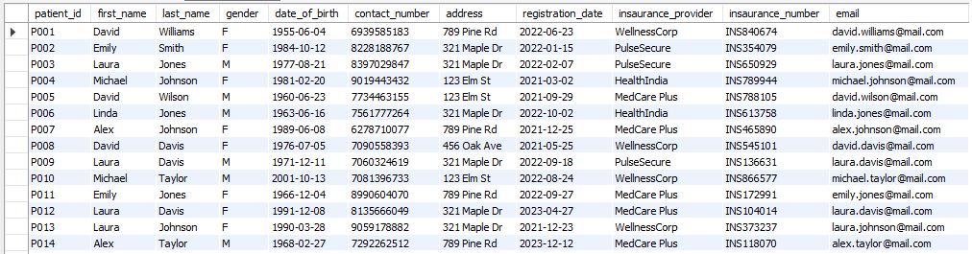
Table Content
select * from doctors;
select * from patients;
09

Slide 11
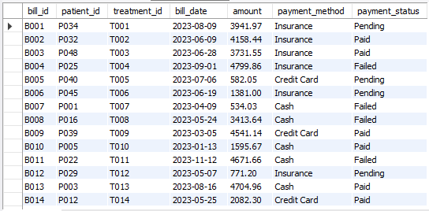
Table Content
select * from billing;
10

Slide 12
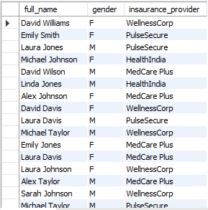
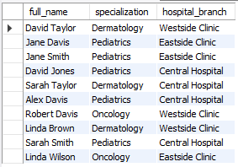
Basic SQL & Data Understanding
1. List all patients with their full name, gender, and insurance provider
select concat(first_name, ' ', last_name) as full_name, gender, insaurance_provider from patients;
2. Show all doctors and their specializations and hospital branches
select concat(first_name, ' ', last_name) as full_name, specialization, hospital_branch from doctors;
11

Slide 13
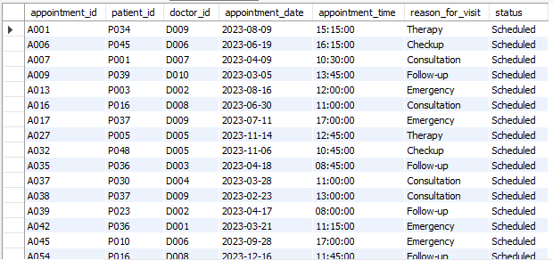
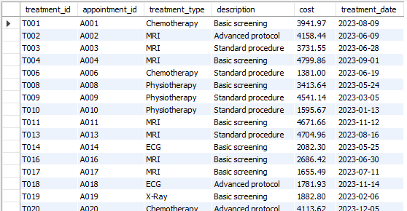
Basic SQL & Data Understanding
3. Retrieve all appointments with status is 'Scheduled'.
select * from appointments where status = 'Scheduled';
4. Display treatments that cost more than 1,000
select * from treatments where cost>1000;
12

Slide 14
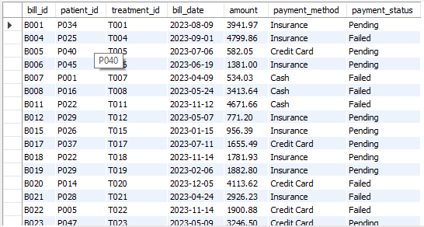
Basic SQL & Data Understanding
5. List all unpaid bills
select * from billing where payment_status IN ('Pending' , 'Failed');
13

Slide 15


Patient Analytics
1. Count the total number of patients by gender
select gender,count(*) from patients group by gender;
2. Identify patients who do not have insurance
select concat(p.first_name, ' ', p.last_name) as full_name, a.patient_id from appointments a left join patients p on p.patient_id= a.patient_id where p.insaurance_provider is null;
14

Slide 16
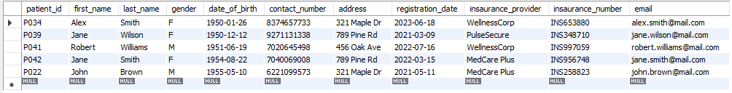
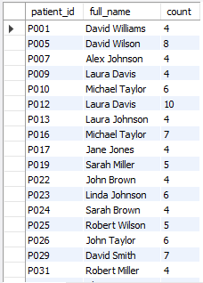
Patient Analytics
3. Find the top 5 oldest patients
select * from patients order by date_of_birth asc LIMIT 5;
4. Find patients who have had more than 3 appointments
select p.patient_id, concat(p.first_name, ' ', p.last_name) as full_name, count(a.appointment_id) as count from patients p left join appointments a on p.patient_id = a.patient_id group by patient_id, full_name having count>3;
15

Slide 17

Patient Analytics
5. List patients who have never had an appointment
select p.patient_id, concat(p.first_name, ' ', p.last_name) as full_name, count(a.appointment_id) as count from patients p left join appointments a on p.patient_id = a.patient_id group by patient_id, full_name having count=0;
16

Slide 18

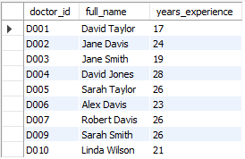
Doctor & Staff Performance Analysis
1. Count the number of doctors per specialization
select specialization, count(doctor_id) as count from doctors group by specialization;
2. Find doctors with more than 10 years of experience
select doctor_id, concat(first_name, ' ', last_name) as full_name, years_experience from doctors where years_experience>=10;
17

Slide 19


Doctor & Staff Performance Analysis
3. Identify doctors who have handled the highest number of appointments
select d.doctor_id, concat(d.first_name, ' ', d.last_name) as full_name, count(a.appointment_id) as total_appointment from doctors d left join appointments a on d.doctor_id = a.doctor_id group by doctor_id, full_name order by total_appointment Desc Limit 3;
4. Calculate the average years of experience per hospital branch
select hospital_branch, avg(years_experience) from doctors group by hospital_branch;
18

Slide 20

Doctor & Staff Performance Analysis
5. Find doctors who have no appointments scheduled
select d.doctor_id, concat(d.first_name, ' ', d.last_name) as full_name, count(a.appointment_id) as total_appointment from doctors d left join appointments a on d.doctor_id = a.doctor_id group by doctor_id, full_name having total_appointment = 0;
19

Slide 21
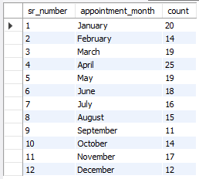

Appointment Analysis
1. Count total appointments per month
select month(appointment_date) as sr_number, monthname(appointment_date) as appointment_month, count(appointment_id) as count from appointments group by appointment_month, sr_number order by sr_number;
2. Find the most common reason for visit
select reason_for_visit, count(appointment_id) as count from appointments group by reason_for_visit order by count desc limit 1;
20

Slide 22

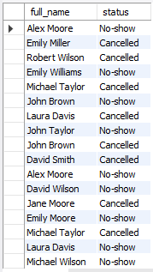

Appointment Analysis
3. Identify the appointment cancellation rate
select status, count(appointment_id) as cancellation_rate from appointments group by status having status = 'Cancelled';
4. Find patients who missed appointments (status = Cancelled or No-Show)
select concat(p.first_name, ' ', p.last_name) as full_name, a.status from appointments a left join patients p on a.patient_id=p.patient_id where status in ('Cancelled', 'No-show');
5. Determine the busiest doctor based on number of appointments
select d.doctor_id, concat(d.first_name, ' ', d.last_name) as full_name, count(a.appointment_id) as count from appointments a left join doctors d on a.doctor_id = d.doctor_id group by full_name, doctor_id order by count desc limit 1;
21

Slide 23
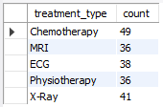
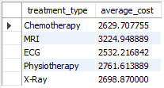

Treatment & Medical Insights
1. Count the number of treatments per treatment type
select treatment_type, count(treatment_id) as count from treatments group by treatment_type;
3. Calculate the average treatment cost
select treatment_type, avg(cost) as average_cost from treatments group by treatment_type;
2. Find the most expensive treatment
select treatment_type, cost from treatments order by cost desc limit 1;
22

Slide 24
Treatment & Medical Insights
4. List appointments that resulted in multiple treatments
select appointment_id, count(treatment_id) AS treatment_count from treatments t group by appointment_id having count(treatment_id) > 1;
5. Identify treatments that were never billed
select t.treatment_id, b.bill_id from treatments t left join billing b on t.treatment_id = b.treatment_id where b.bill_id is null;
23

Slide 25

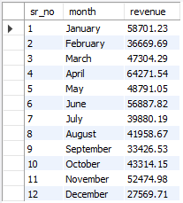
Billing & Revenue Analysis
1. Calculate total revenue generated by the hospital
select sum(amount) as total_revenue from billing;
2. Find total revenue per month
select month(bill_date) as sr_no, monthname(bill_date) as month, sum(amount) from billing group by month,sr_no order by sr_no asc;
24

Slide 26

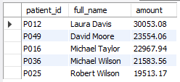

Billing & Revenue Analysis
3. Identify the top 5 patients by total billing amount
select p.patient_id, concat(p.first_name, ' ', p.last_name) as full_name, sum(b.amount) as amount from billing b left join patients p on b.patient_id = p.patient_id group by full_name, patient_id order by amount desc limit 5;
4. Calculate pending (unpaid) amount
select sum(amount) as unpaid_amount from billing where payment_status in ('Pending', 'Failed');
5. Find the most common payment method
select payment_method, count(bill_id) as count from billing group by payment_method order by count desc limit 1;
25

Slide 27
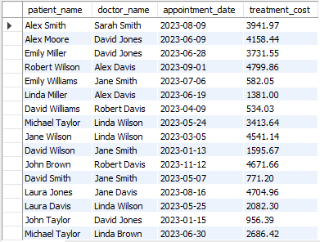

Advanced JOIN
1. Display patient name, doctor name, appointment date, and treatment cost
select concat(p.first_name, ' ', p.last_name) as patient_name, concat(d.first_name, ' ', d.last_name) as doctor_name, a.appointment_date, t.cost as treatment_cost from appointments a left join patients p on p.patient_id = a.patient_id left join doctors d on a.doctor_id = d.doctor_id left join treatments t on a.appointment_id = t.appointment_id;
2. Find doctors whose patients generated the highest total revenue
select concat(d.first_name, ' ', d.last_name) as doctor_name, sum(b.amount) as revenue from appointments a left join doctors d on d.doctor_id = a.doctor_id left join billing b on a.patient_id = b.patient_id group by doctor_name order by revenue desc limit 1;
26

Slide 28
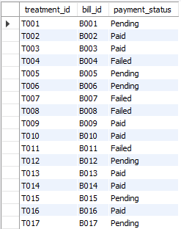


Advanced JOIN
3. Identify patients who had appointments but no treatments
select p.patient_id, concat(p.first_name, ' ', p.last_name) as patient_name, a.appointment_id, sum(t.treatment_id) as treatments from appointments a left join patients p on a.patient_id = p.patient_id left join treatments t on a.appointment_id = t.appointment_id group by p.patient_id, patient_name, a.appointment_id having count(t.treatment_id)=0;
4. Find treatments along with billing payment status
select t.treatment_id, b.bill_id, b.payment_status from treatments t left join billing b on t.treatment_id = b.treatment_id;
5. Show hospital branch-wise total revenue generated
select d.hospital_branch, sum(t.cost) as revenue from appointments a left join doctors d on a.doctor_id = d.doctor_id left join treatments t on a.appointment_id = t.appointment_id group by hospital_branch;
27

Slide 29
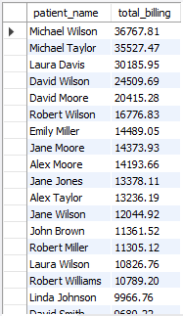
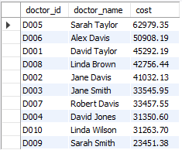
Subqueries & CTEs (Advanced Analytics)
1. Find patients whose total billing is above average
select concat(p.first_name, ' ', p.last_name) as patient_name, sum(b.amount) as total_billing from patients p left join billing b on p.patient_id = b.patient_id where amount > (select avg(amount) as amount from billing) group by patient_name order by total_billing DESC;
2. Identify doctors who treat patients with high-cost treatments (> avg)
select d.doctor_id, concat(d.first_name, ' ', d.last_name) as doctor_name, sum(t.cost) as cost from appointments a left join doctors d on d.doctor_id = a.doctor_id left join treatments t on a.appointment_id = t.appointment_id where cost > (select avg(cost) as cost from treatments) group by doctor_id, doctor_name order by cost DESC;
28

Slide 30
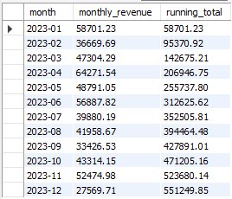

Subqueries & CTEs (Advanced Analytics)
4. Find the second highest billed patient
with PatientBilling as (select p.patient_id, concat(p.first_name, ' ', p.last_name) as patient_name, sum(b.amount) as total_billed, dense_rank() over (order by SUM(b.amount) desc) as RankNum from billing b left join treatments t on b.treatment_id = t.treatment_id left join appointments a on t.appointment_id = a.appointment_id join patients p on a.patient_id = p.patient_id group by p.patient_id, patient_name) select patient_id, patient_name, total_billed from PatientBilling where RankNum = 2;
5. Calculate running total of monthly revenue
with MonthlyRevenue as (select date_format(treatment_date, '%Y-%m') as month, sum(cost) as monthly_revenue from treatments group by date_format(treatment_date, '%Y-%m')) select month, monthly_revenue, sum(monthly_revenue) over (order by month) as running_total from MonthlyRevenue order by month;
29

Slide 31
Conclusion & Key Insights
  This SQL project demonstrates the use of data analytics to evaluate hospital operations, patient behavior, doctor performance, and revenue trends.
  Using advanced SQL techniques such as joins, subqueries, CTEs, and window functions, actionable insights were derived from multiple interconnected tables.
  The analysis highlights key business drivers, including high-revenue treatments, top-performing doctors, repeat patients, and unpaid billing risks.
  Overall, the project showcases strong SQL proficiency, analytical thinking, and business-oriented problem solving, aligned with real-world healthcare analytics use cases.
30

Slide 32

Saad Ahmed Shaikh
SQL Data Analytics Project
Thank You
Q And A Session

